Slide 1


Takayuki Hayakawa
August 16, 2024

Slide 2

Outline
Executive Summary
Introduction
Methodology
Results
Conclusion
Appendix

Slide 3
Executive Summary
Summary of methodologies
Collecting data on the Falcon 9 first-stage landings using a RESTful API and web scraping. Also converting the data into a dataframe and then perform some data wrangling.
Next building a dashboard to analyze launch records interactively with Plotly Dash. Then building an interactive map to analyze the launch site proximity with Folium.
Finally using machine learning to determine if the first stage of Falcon 9 will land successfully. Splitting the data into training data and test data to find the best Hyperparameter for SVM, Classification Trees, and Logistic Regression. Then find the method that performs best using test data.
Summary of all results
Utilizing the data analysis tools to load a dataset, cleaning it, and finding out interesting insights from it.
Building an interactive map to analyze the launch site proximity.
Utilizing the machine learning skills to build a predictive model to help a business function more efficiently.

Slide 4
Introduction
Project background and context
The commercial space age is here, companies are making space travel affordable for everyone. Perhaps the most successful is SpaceX. One reason SpaceX can do this is the rocket launches are relatively inexpensive.
SpaceX advertises Falcon 9 rocket launches on its website with a cost of 62 million dollars; other providers cost upwards of 165 million dollars each, much of the savings is because SpaceX can reuse the first stage.
Therefore, if we can determine if the first stage will land, we can determine the cost of a launch.
Problems you want to find answers
The problem is to determine the price of each launch. Doing this by gathering information about Space X and creating dashboards and also to determine if SpaceX will reuse the first stage.
Instead of using rocket science to determine if the first stage will land successfully, I train a machine learning model and use public information to predict if SpaceX will reuse the first stage.

Slide 5

Section 1

Slide 6
Methodology
Executive Summary
Data collection methodology:
Collecting data on the Falcon 9 first-stage landings using a RESTful API and web scraping.
Perform data wrangling
Converting the data into a dataframe and then perform some data wrangling.
Perform exploratory data analysis (EDA) using visualization and SQL
Perform interactive visual analytics using Folium and Plotly Dash
Perform predictive analysis using classification models
Using machine learning to determine if the first stage of Falcon 9 will land successfully. First splitting the data into training data and test data to find the best Hyperparameter for SVM, Classification Trees, and Logistic Regression. Then finding the method that performs best using test data.

Slide 7
Data Collection
Describe how data sets were collected.
To collecting data sets, making a get request to the SpaceX API, and also doing some basic data wrangling and formating.
Request to the SpaceX API
Clean the requested data
You need to present your data collection process use key phrases and flowcharts
Import Libraries and Define Auxiliary Functions
Request rocket launch data from SpaceX API with the following URL:
https://api.spacexdata.com/v4/launches/past
Request and parse the SpaceX launch data using the GET request
https://cf-courses-data.s3.us.cloud-object-storage.appdomain.cloud/IBM-DS0321EN-SkillsNetwork/datasets/API_call_spacex_api.json
Filter the dataframe to only include Falcon 9 launches
Dealing with Missing Values

Slide 8
Data Collection – SpaceX API
Present your data collection with SpaceX REST calls using key phrases and flowcharts
Add the GitHub URL of the completed SpaceX API calls notebook (must include completed code cell and outcome cell), as an external reference and peer-review purpose
https://github.com/briskwalking53/SpaceXFalcon9firststageLandingPrediction/blob/main/jupyter-labs-spacex-data-collection-api.ipynb
Request rocket launch data from SpaceX API with the following URL:
response = requests.get(spacex_url)

Slide 9
Data Collection - Scraping
Present your web scraping process using key phrases and flowcharts
Add the GitHub URL of the completed web scraping notebook, as an external reference and peer-review purpose
https://github.com/briskwalking53/SpaceXFalcon9firststageLandingPrediction/blob/main/jupyter-labs-spacex-data-collection-api.ipynb
To make the requested JSON results more consistent, use the following static response object for this project:
Decode the response content as a Json using .json() and turn it into a Pandas dataframe using .json_normalize()
To get information about the launches using the IDs given for each launch, and also specifically using columns rocket, payloads, launchpad, and cores.
Remove the Falcon 1 launches keeping only the Falcon 9 launches. Filter the data dataframe using the BoosterVersion column to only keep the Falcon 9 launches. Save the filtered data to a new dataframe called data_falcon9.

Slide 10
Data Wrangling
Describe how data were processed
Dealing with Missing Values
The LandingPad column will retain None values to represent when landing pads were not used.
You need to present your data wrangling process using key phrases and flowcharts
Add the GitHub URL of your completed data wrangling related notebooks, as an external reference and peer-review purpose
https://github.com/briskwalking53/SpaceXFalcon9firststageLandingPrediction/blob/main/jupyter-labs-spacex-data-collection-api.ipynb
Calculate the mean for the PayloadMass using the .mean().
Then use the mean and the .replace() function to replace np.nan values in the data with the mean calculated above.

Slide 11
EDA with Data Visualization
Summarize what charts were plotted and why you used those charts
Plot out the FlightNumber vs. PayloadMass to see how their variables would affect the launch outcome.
Plot out the FlightNumber vs LaunchSite to see the relationship between Flight Number and Launch Site.
Plot out the Payload Mass and Launch Site to see the relationship between Payload Mass and Launch Site.
Plot out the Orbit and Class to see the relationship between success rate of each orbit type.
Plot out the FlightNumber and Orbit to see the relationship between FlightNumber and Orbit type.
Plot out the Payload Mass and Orbit to see the relationship between Payload Mass and Orbit type.
Plot out the Year and average success rateto see the launch success yearly trend
Add the GitHub URL of your completed EDA with data visualization notebook, as an external reference and peer-review purpose
https://github.com/briskwalking53/SpaceXFalcon9firststageLandingPrediction/blob/main/edadataviz.ipynb

Slide 12
EDA with SQL
Using bullet point format, summarize the SQL queries you performed
Display the names of the unique launch sites in the space mission
Display 5 records where launch sites begin with the string ‘CCA'
Display the total payload mass carried by boosters launched by NASA (CRS)
Display average payload mass carried by booster version F9 v1.1
List the date when the first succesful landing outcome in ground pad was acheived
List the names of the boosters which have success in drone ship and have payload mass greater than 4000 but less than 6000
List the total number of successful and failure mission outcomes
List the names of the booster_versions which have carried the maximum payload mass. Use a subquery
List the records which will display the month names, failure landing_outcomes in drone ship ,booster versions, launch_site for the months in year 2015.
Rank the count of landing outcomes between the date 2010-06-04 and 2017-03-20, in descending order.
Add the GitHub URL of your completed EDA with SQL notebook, as an external reference and peer-review purpose
https://github.com/briskwalking53/SpaceXFalcon9firststageLandingPrediction/blob/main/jupyter-labs-eda-sql-coursera_sqllite.ipynb

Slide 13
Build an Interactive Map with Folium
Summarize what map objects such as markers, circles, lines, etc. you created and added to a folium mapa nd explain why you added those objects
Create a folium Map object to see an initial center location to be NASA Johnson Space Center at Houston, Texas.
Add a circle for each launch site in data frame launch_sites.
Create markers for all launch records to see if a launch was successful.
Add a MousePosition on the map to get coordinate for a mouse over a point on the map.
Mark down a point on the closest coastline using MousePosition and calculate the distance between the coastline point and the launch site.
Draw a line between a launch site to its closest city, railway, highway, and etc. to answer launch sites in close proximity to railways, haigway, coastline and city.
Add the GitHub URL of your completed interactive map with Folium map, as an external reference and peer-review purpose
https://github.com/briskwalking53/SpaceXFalcon9firststageLandingPrediction/blob/main/lab_jupyter_launch_site_location.ipynb

Slide 14
Build a Dashboard with Plotly Dash
Summarize what plots/graphs and interactions you have added to a dashboard and explain why you added those plots and interactions
Pie chart with drop-down list to see the total sucess launches for sites.
Scatter point chart with range-slider to see the correltion between Payload and Success for sites
Add the GitHub URL of your completed Plotly Dash lab, as an external reference and peer-review purpose
https://github.com/briskwalking53/SpaceXFalcon9firststageLandingPrediction/blob/main/spacex_dash_app.py

Slide 15
Predictive Analysis (Classification)
Perform exploratory Data Analysis and determine Training Labels
Create a column for the class
Standardize the data
Split into training data and test data
Find best Hyperparameter for SVM, Classification Trees and Logistic Regression
Find the method performs best using test data
Add the GitHub URL of your completed predictive analysis lab, as an external reference and peer-review purpose
https://github.com/briskwalking53/SpaceXFalcon9firststageLandingPrediction/blob/main/SpaceX_Machine Learning Prediction_Part_5.ipynb
Load the data.
Create a NumPy array from the column Class in data, then assign it to the variable Y.
Standardize the data in X then reassign it to the variable X.
Use the function train_test_split to split the data X and Y into training and test data.
Create a logistic regression object then create a GridSearchCV object logreg_cv with cv = 10. Fit the object to find the best parameters from the dictionary parameters.
Calculate the accuracy on the test data using the method score.
Create a support vector machine object then create a GridSearchCV object svm_cv with cv = 10. Fit the object to find the best parameters from the dictionary parameters.
Calculate the accuracy on the test data using the method score.
Create a decision tree classifier object then create a GridSearchCV object tree_cv with cv = 10. Fit the object to find the best parameters from the dictionary parameters.
Calculate the accuracy of tree_cv on the test data using the method score.
Create a k nearest neighbors object then create a GridSearchCV object knn_cv with cv = 10. Fit the object to find the best parameters from the dictionary parameters.
Calculate the accuracy of knn_cv on the test data using the method score.
Find the method performs best.

Slide 16
Results
Exploratory data analysis results
The larger the Flight Number, the better the success rate at launch sites
The VAFB-SLC launch site there are no rockets launched for heavypayload mass(greater than 10000).
ES-L1, GEO, HEO and SSO have the highest success rates.
The success rate since 2013 kept increasing till 2020.
Find the total number of successful and failure mission outcomes
Interactive analytics demo in screenshots
Interactive analytics is able to identify launch sites easier.
Predictive analysis results
Predictive analysis shows Decision Tree is the best model to predict successful landings, having accuracy about 87%.

Slide 17

Section 2

Slide 18
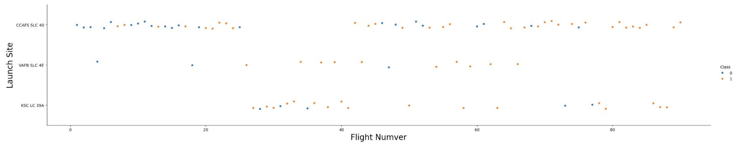
Flight Number vs. Launch Site
The larger the Flight Number, the better the success rate at launch sites

Slide 19
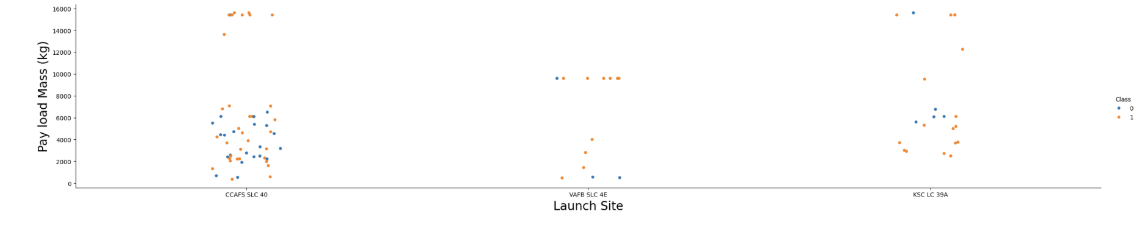
Payload vs. Launch Site
The VAFB-SLC launch site there are no rockets launched for heavypayload mass(greater than 10000).

Slide 20
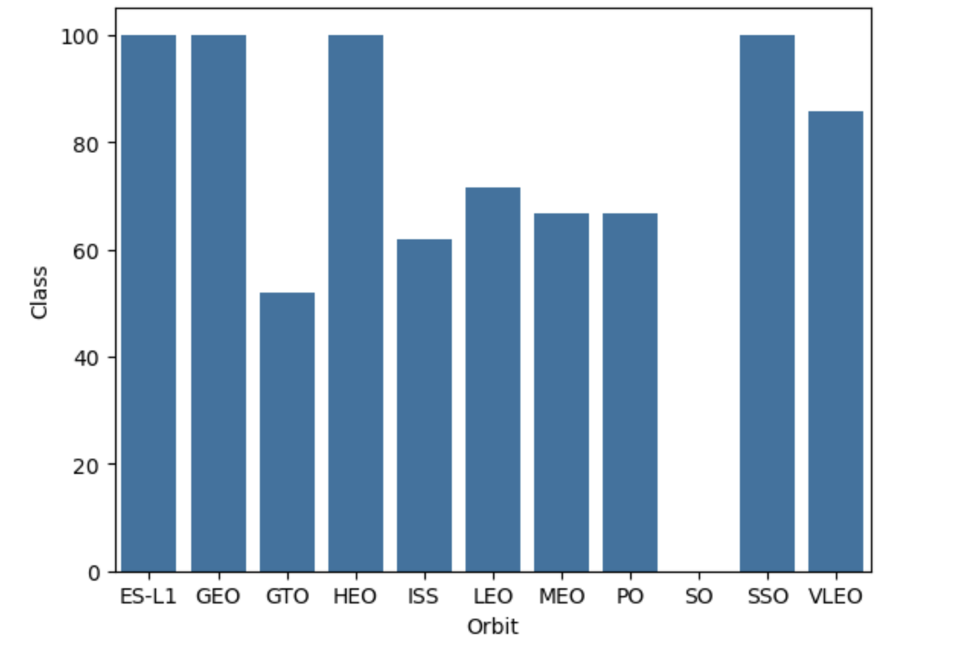
Success Rate vs. Orbit Type
ES-L1, GEO, HEO and SSO have the highest success rates.

Slide 21
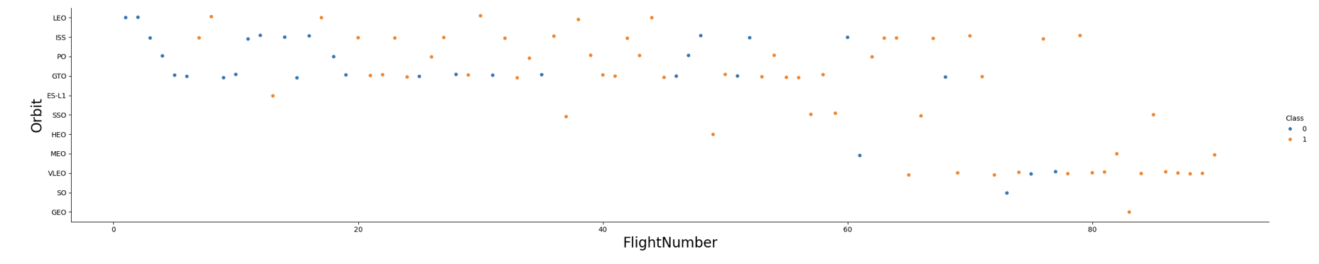
Flight Number vs. Orbit Type
In the LEO orbit, success is related to the number of flights. Conversely, in the GTO orbit, there appears to be no relationship between flight number and success.

Slide 22
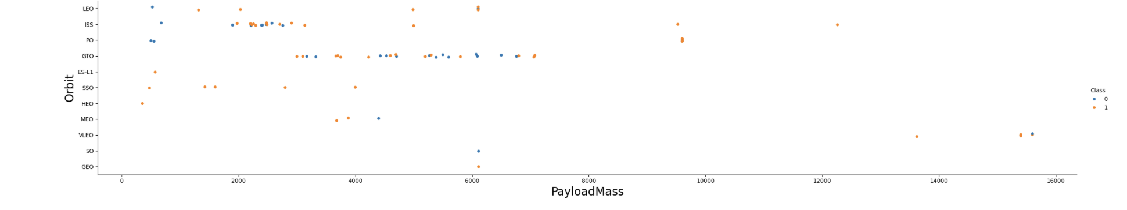
Payload vs. Orbit Type
With heavy payloads the successful landing or positive landing rate are more for Polar,VLEO and ISS.
However, for GTO, it's difficult to distinguish between successful and unsuccessful landings as both outcomes are present.

Slide 23
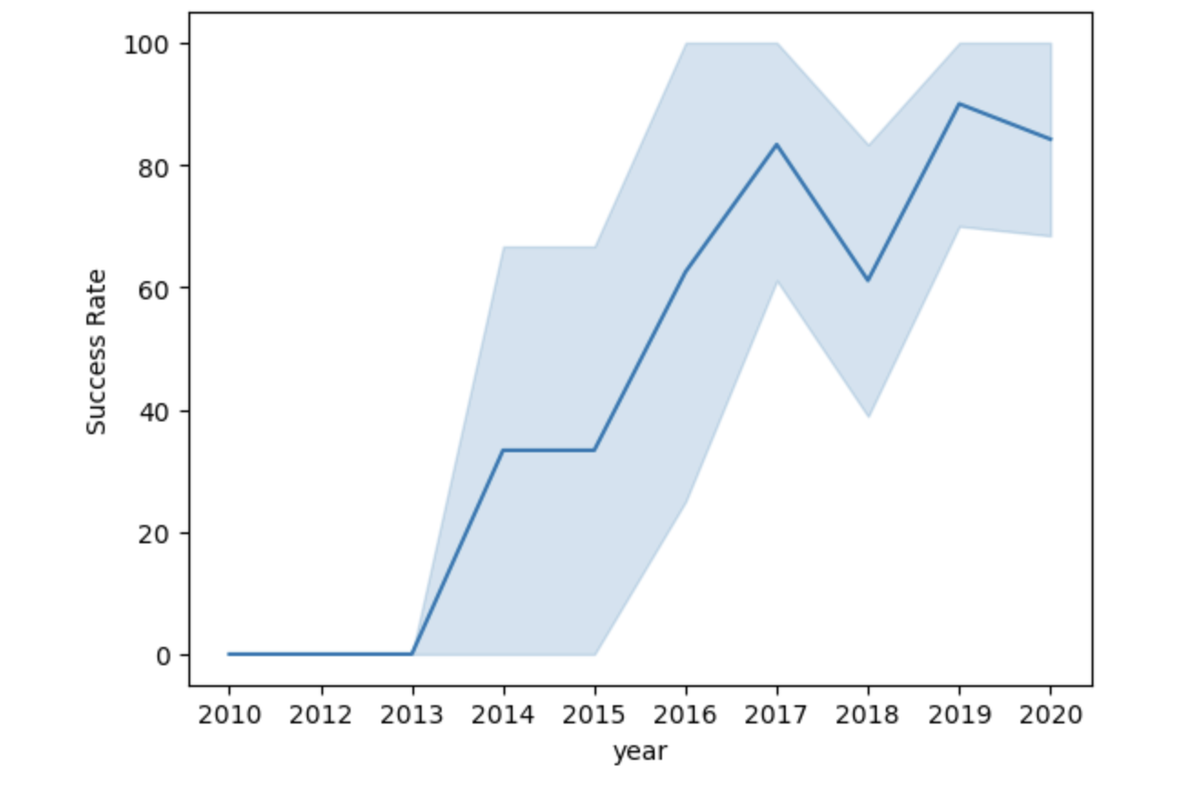
Launch Success Yearly Trend
The success rate since 2013 kept increasing till 2020.

Slide 24
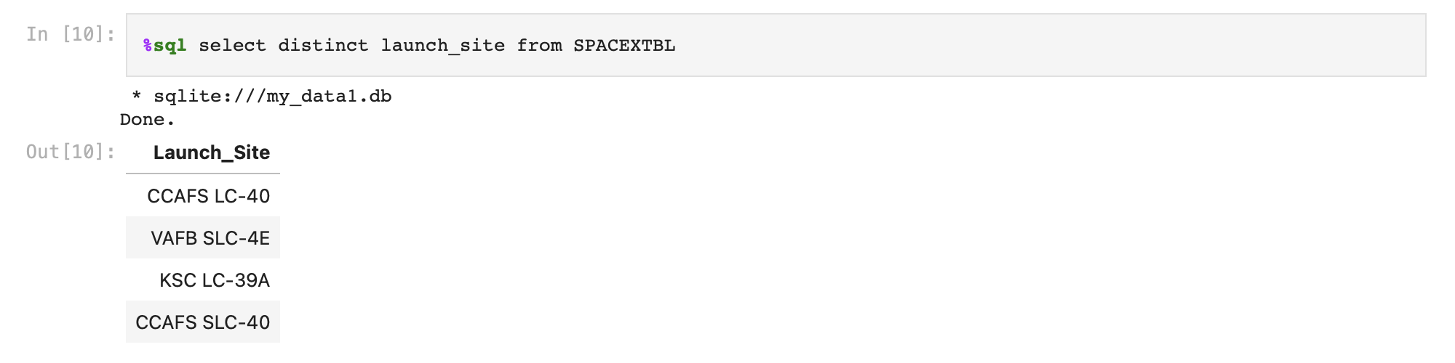
All Launch Site Names
Display the names of the unique launch sites in the space mission using DISTINCT.

Slide 25
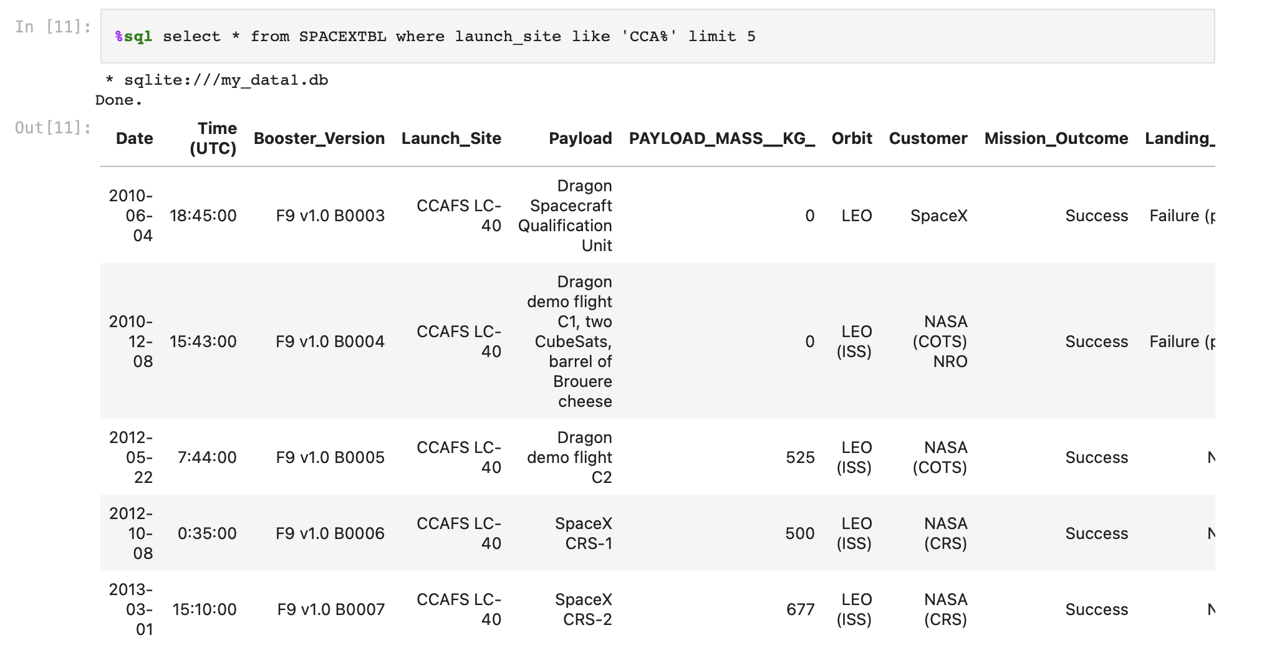
Launch Site Names Begin with 'CCA'
Display 5 records where launch sites begin with the string ‘CCA' using LIKE,% and LIMIT.

Slide 26
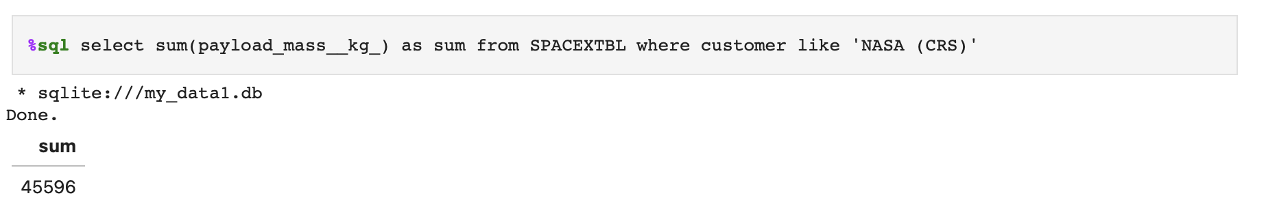
Total Payload Mass
Display the total payload mass carried by boosters launched by NASA (CRS) using SUM.

Slide 27
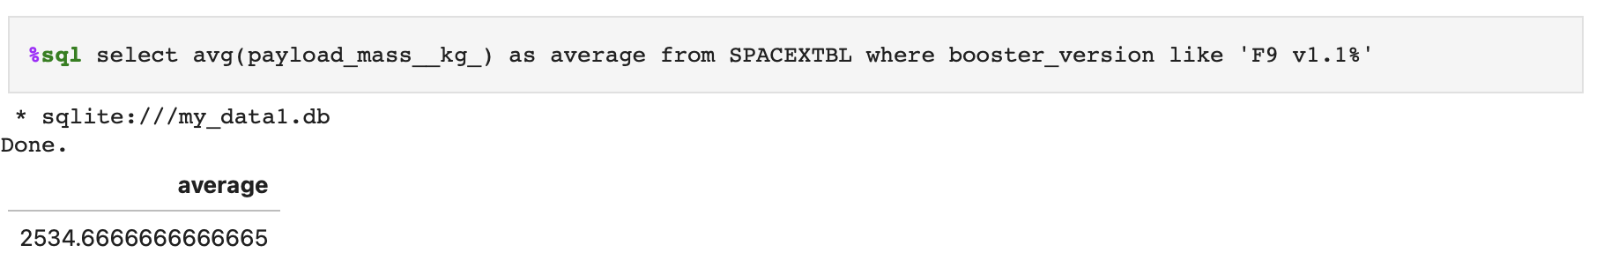
Average Payload Mass by F9 v1.1
Display average payload mass carried by booster version F9 v1.1 using AVG.

Slide 28
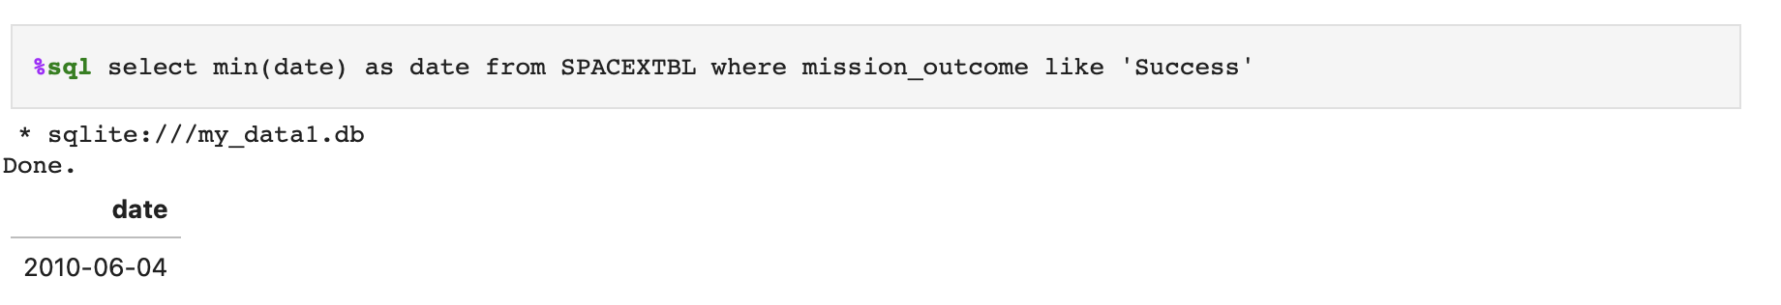
First Successful Ground Landing Date
List the date when the first succesful landing outcome in ground pad was acheived using MIN.

Slide 29
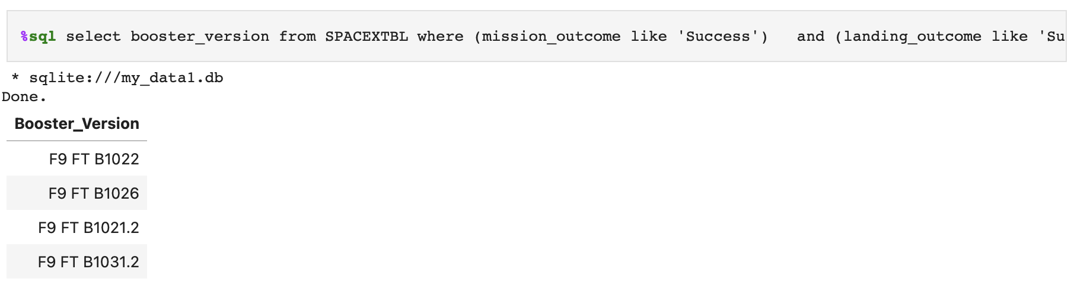
Successful Drone Ship Landing with Payload between 4000 and 6000
List the names of the boosters which have success in drone ship and have payload mass greater than 4000 but less than 6000.

Slide 30
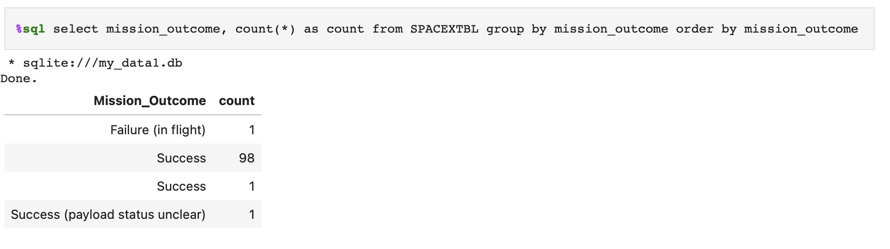
Total Number of Successful and Failure Mission Outcomes
List the total number of successful and failure mission outcomes using COUNT, GROUP BY and ORDER BY.

Slide 31
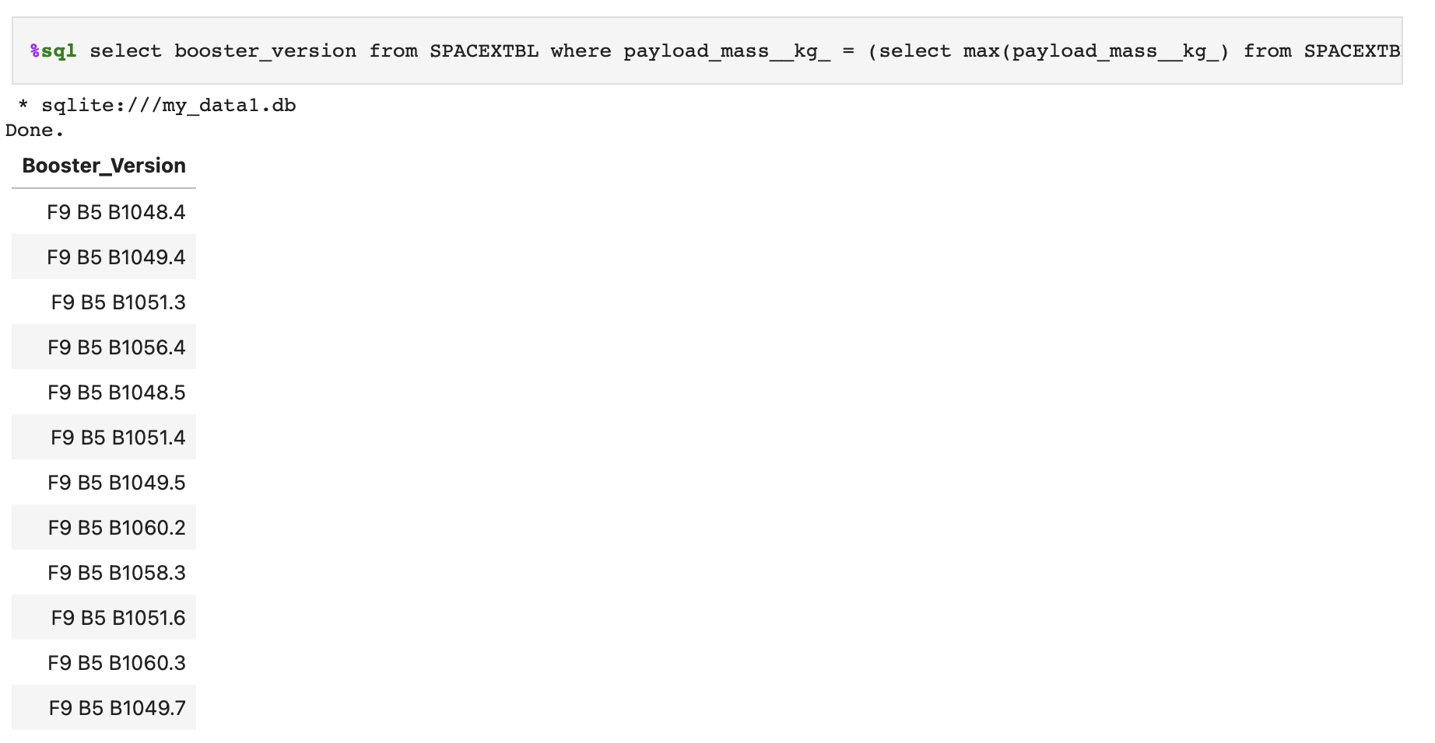
Boosters Carried Maximum Payload
List the names of the booster_versions which have carried the maximum payload mass using a subquery

Slide 32
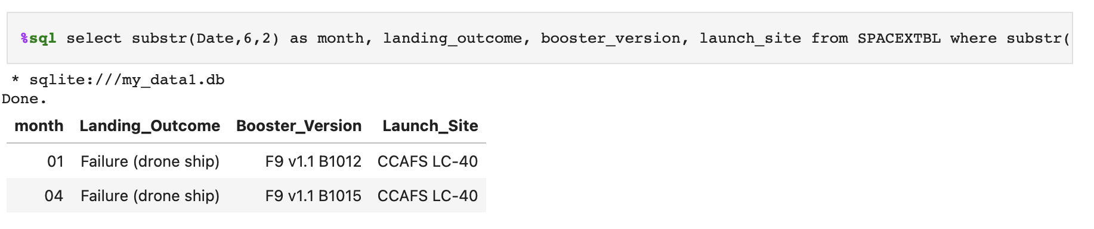
2015 Launch Records
List the records which will display the month names, failure landing_outcomes in drone ship ,booster versions, launch_site for the months in year 2015 using SUBSTR.

Slide 33
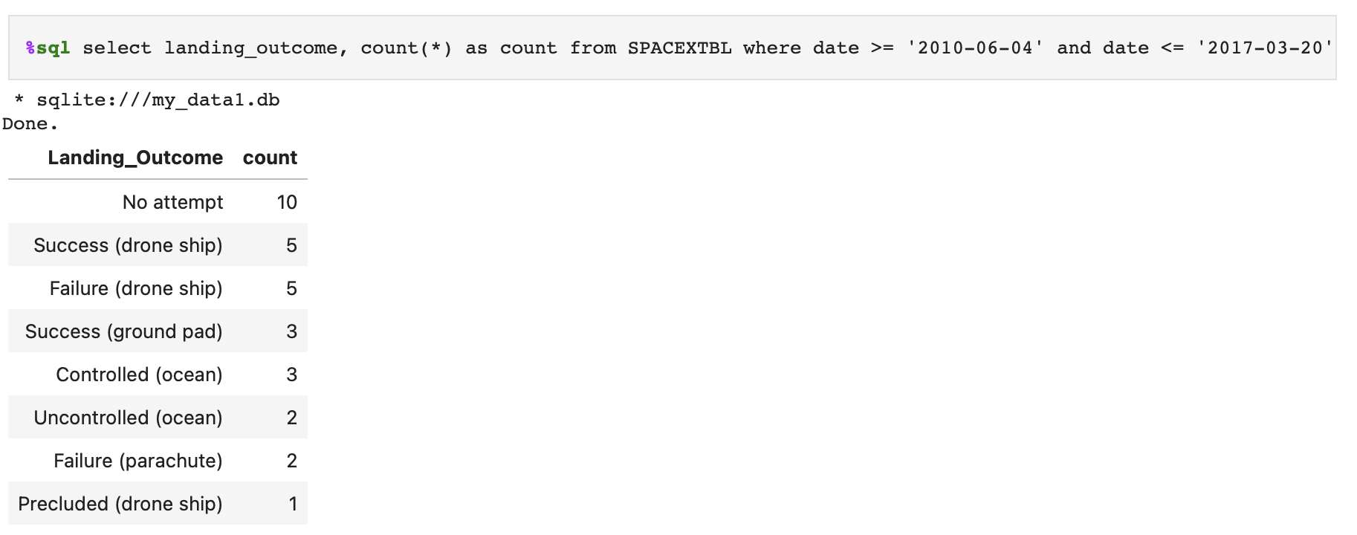
Rank Landing Outcomes Between 2010-06-04 and 2017-03-20
Rank the count of landing outcomes (such as Failure (drone ship) or Success (ground pad)) between the date 2010-06-04 and 2017-03-20, in descending order.

Slide 34

Section 3

Slide 35
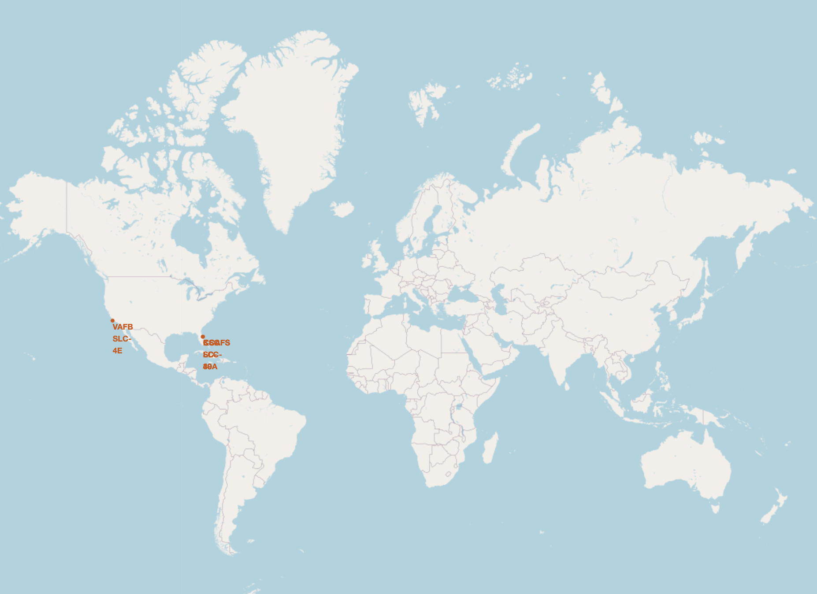
All launch sites’ location markers on a global map
See the two launch sites in the United States of America.

Slide 36
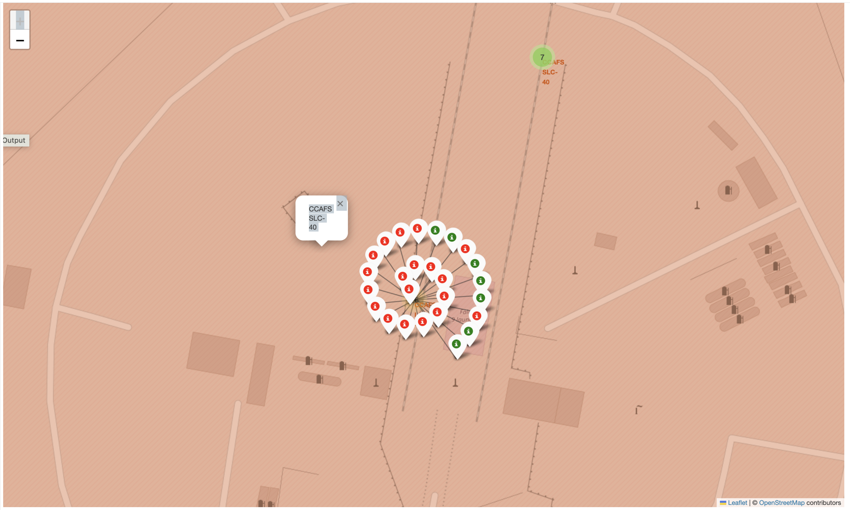
Color-labeled launch outcomes on the map
Green markers show successful and Reds show failures in CCAFS SCL-40.

Slide 37
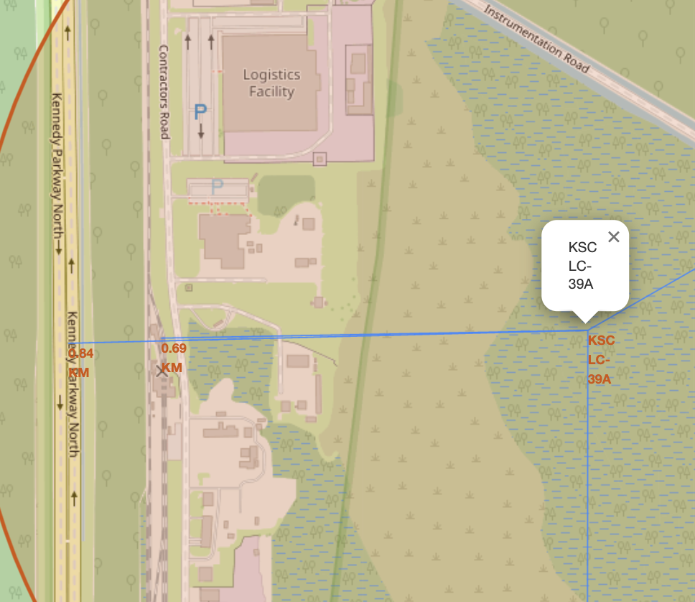
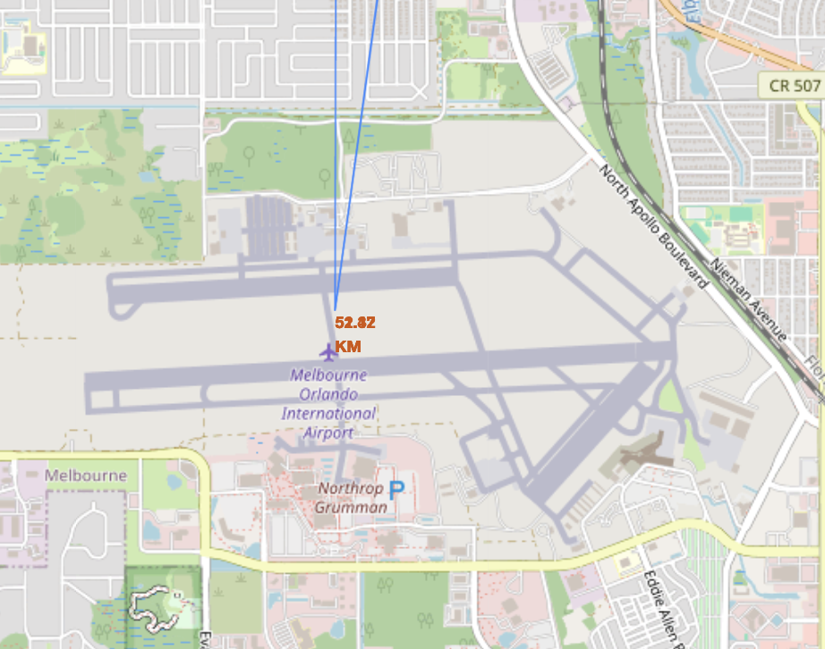
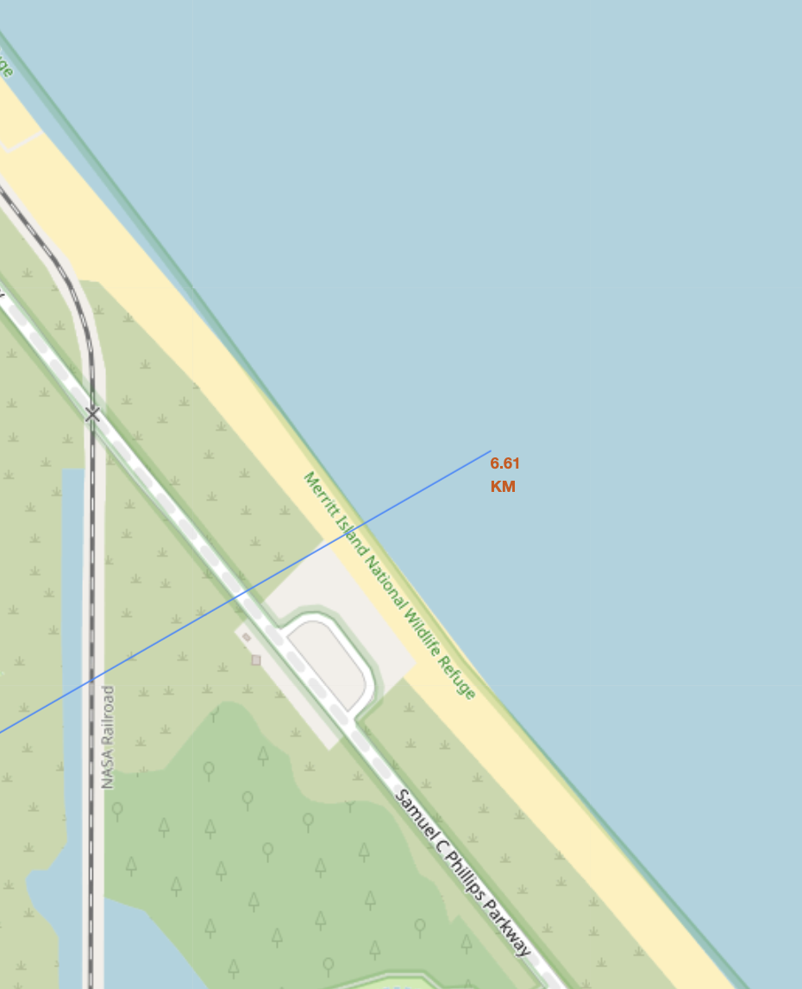
Launch site to its proximities such as railway, highway, coastline with distance
Railway is closest to KSC LC-39.

Slide 38

Section 4

Slide 39
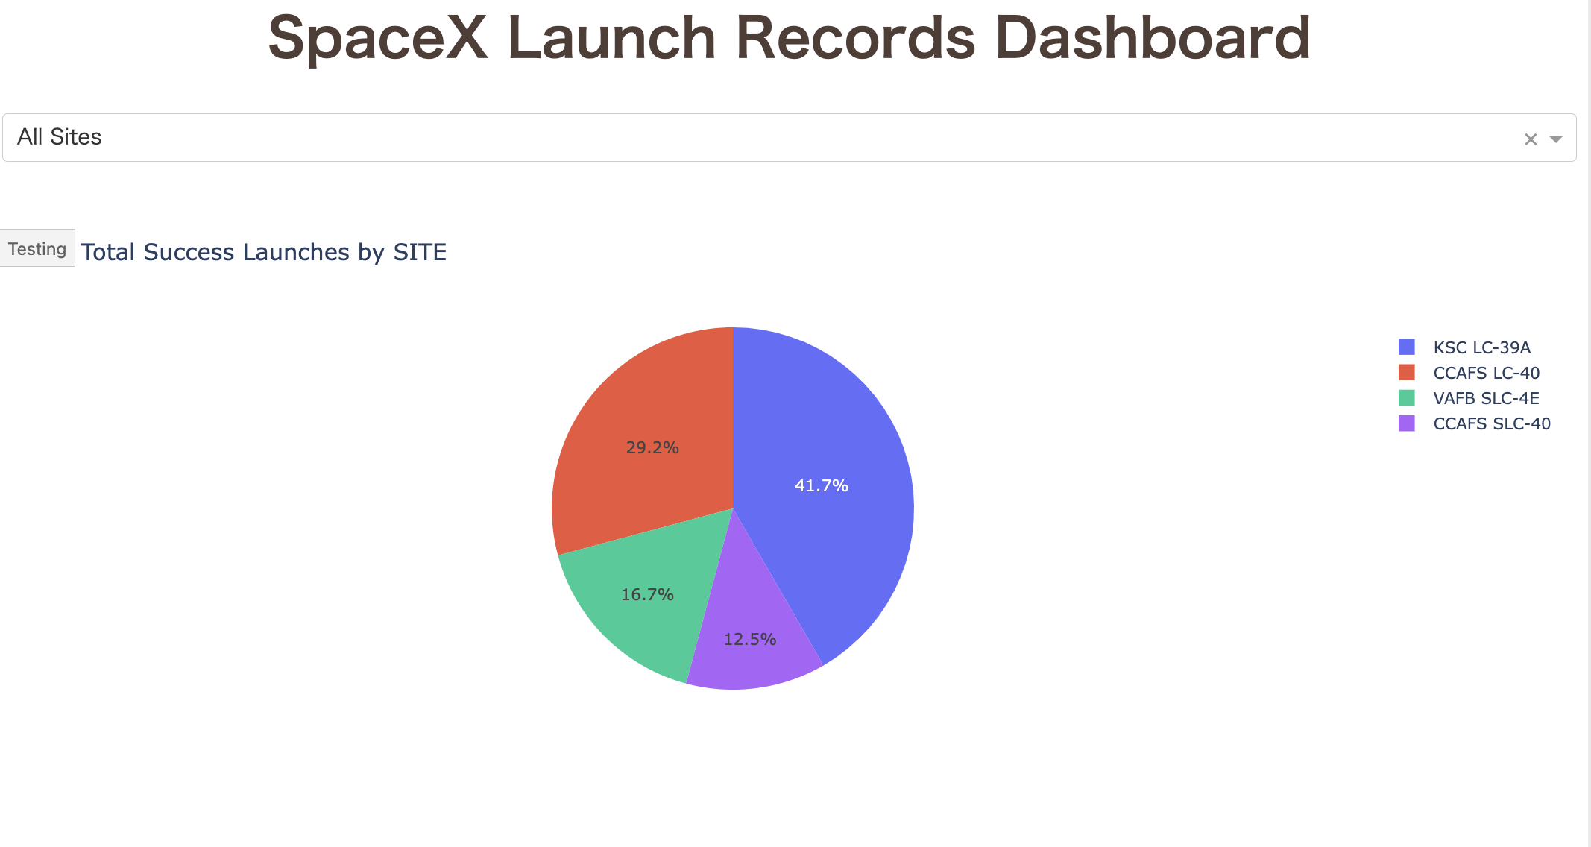
Launch success count for all sites
KSC LC-39A had most successful launches in all sites.

Slide 40
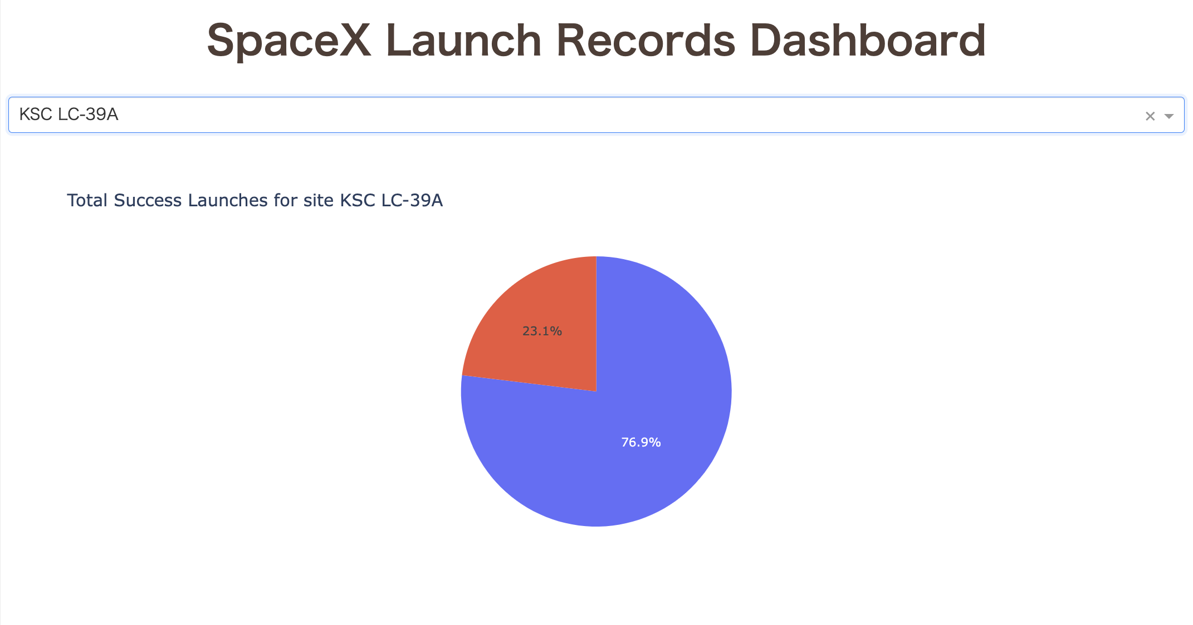
Launch site with highest launch success ratio
KSC LC-39A had 76.9% success rate.

Slide 41
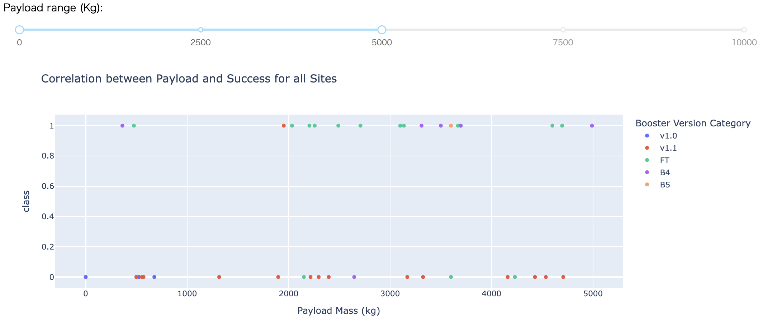
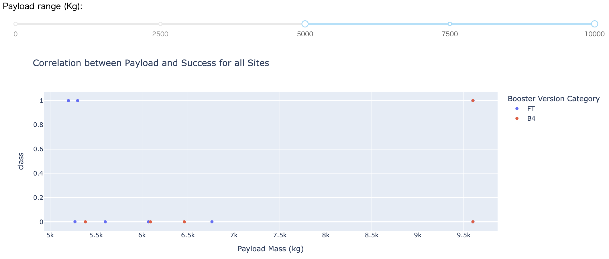
Payload vs. Launch Outcome for all sites, with different payload selected in the range slider
Success rate of light Payload Mass is higher than heavy.

Slide 42

Section 5

Slide 43
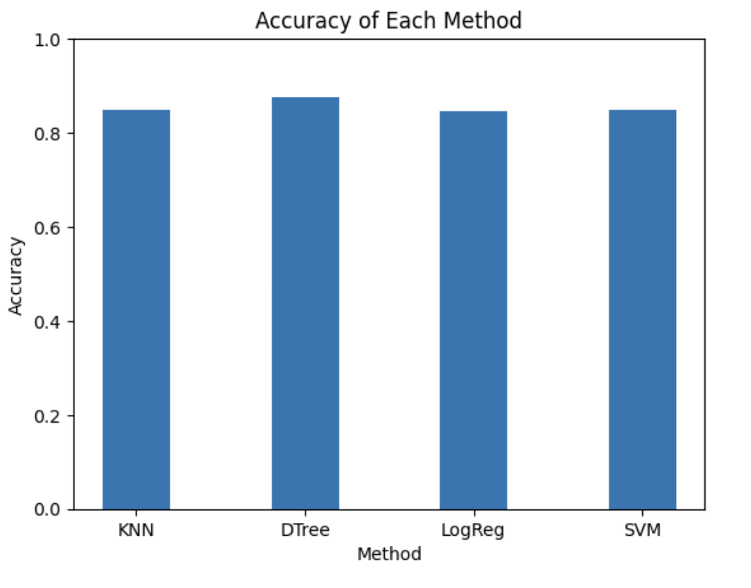
Classification Accuracy
Decision Tree model has the highest classification accuracy.

Slide 44
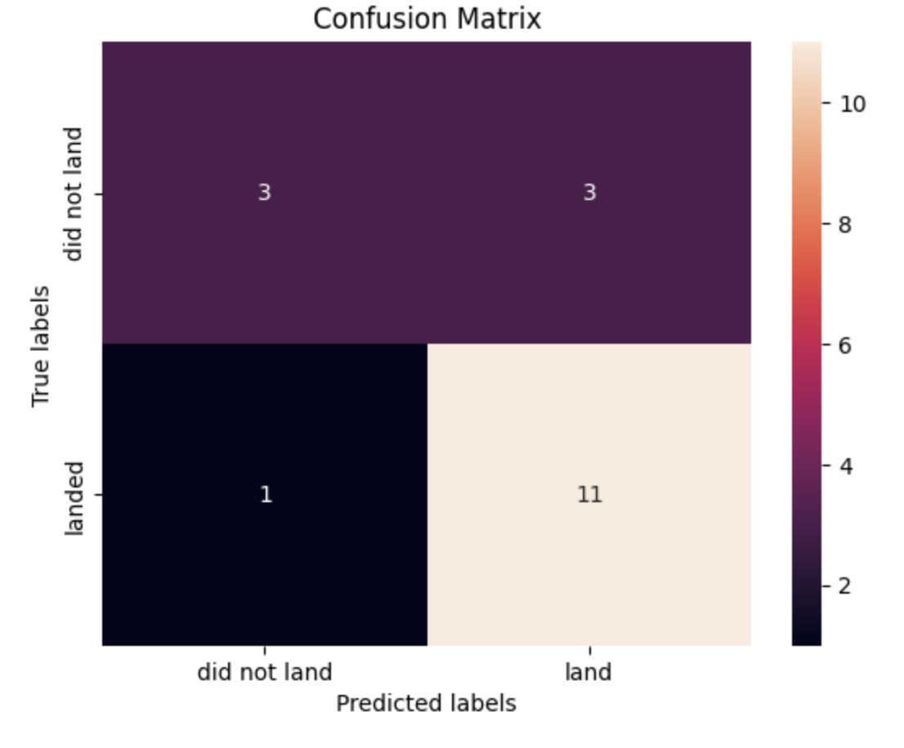
Confusion Matrix
Decision Tree can distinguish between the different classes. And the major problem is false positives.

Slide 45
Conclusions
The larger the Flight Number, the better the success rate at launch sites.
Orbit type : ES-L1, GEO, HEO and SSO have the highest success rates.
The success rate since 2013 kept increasing till 2020.
KSC LC-39A had most successful launches in all sites. IT had 76.9% success rate.
Success rate of light Payload Mass is higher than heavy.
Decision Tree model has the highest classification accuracy.

Slide 46


